Slide 1
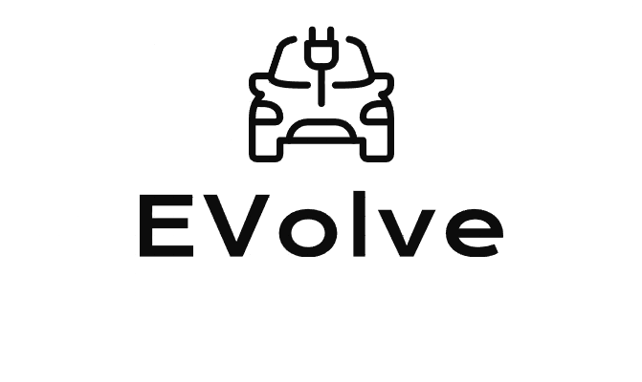

Capstone Project Phase A
Choosing Best Fit Framework For Web Application “EVolve”
Supervisor: Mr. Alexander Keselman
Team members: Daniel Moshe Ben David, Idan Daar

Slide 2
Table Of Contents
01
Introduction & Problem Statement
02
Research & Engineering Process
03
Solution Overview
04
Verification Plan
05
Challenges

Slide 3
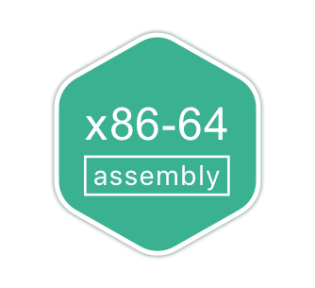
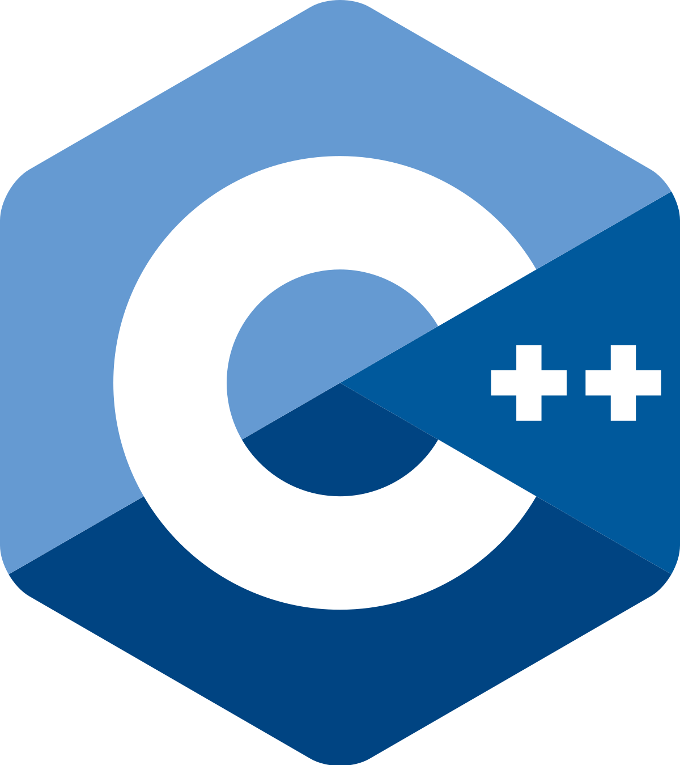


Introduction
When a software engineer is asked to program an algorithm, the first question they often ask themselves is, "In which programming language should I implement it?"

Slide 4
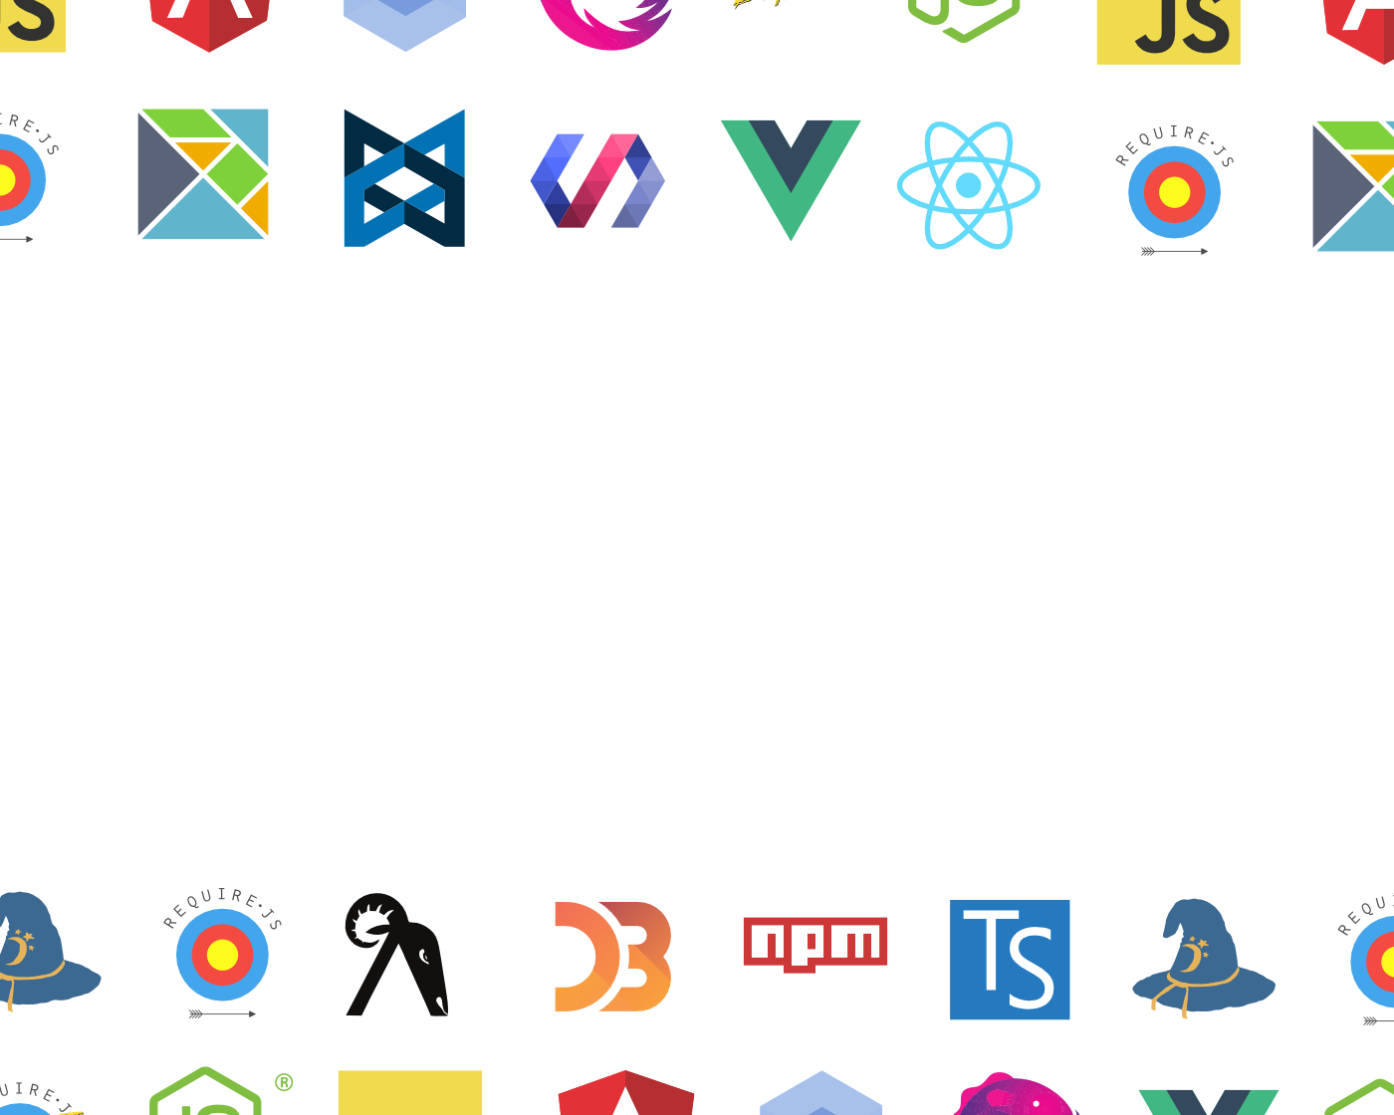
The exact same challenge arises for web developers as well, Web developer has to choose a framework to implement his website on.
The constant introduction of new frameworks has resulted in an overwhelming number of options, estimated to be between 10,000 and 15,000 frameworks that currently exist today.
Introduction

Slide 5
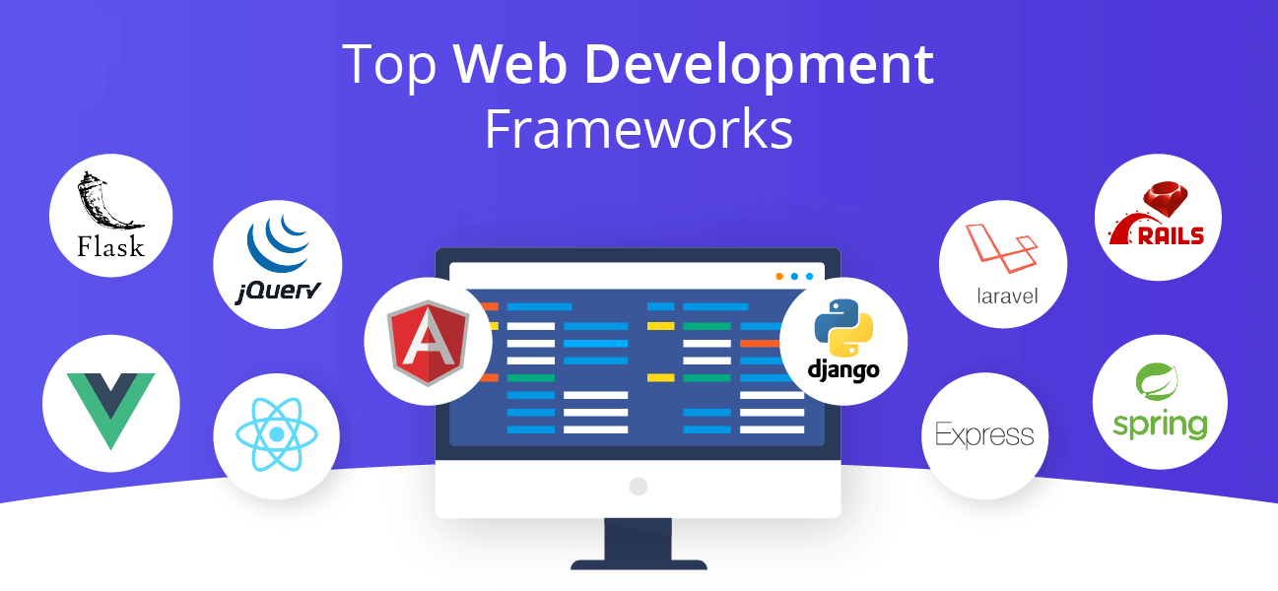
This made it challenging for developers to choose the best framework for their web applications.
Problem Statement

Slide 6

Motivation: we face the problem of choosing the best frameworks for our web application.
Our goal: We aim to provide web developers with a comprehensive solution that enables them to make informed decisions when choosing a framework for their web application development.
Problem Statement

Slide 7
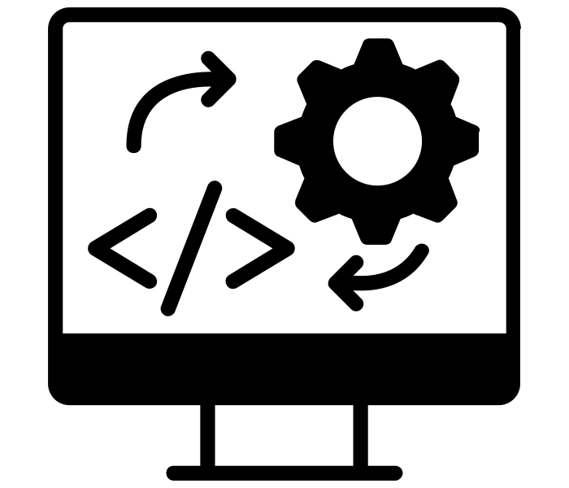
Our engineering process started by researching academy-level articles to understand the variances among the popular frameworks, which let us to identify the most fitting solution for our project - EVolve.
Research
&
Engineering Process

Slide 8
Electric Vehicle evolution
Evolve is a web application that offers electric vehicle owners a convenient way to locate the nearest available charging station. Our development process began with defining the Use Case and Activity diagrams, followed by designing the Graphical User Interface. These steps have been instrumental in helping us understand the requirements and needs of the application.
Research
&
Engineering Process

Slide 9
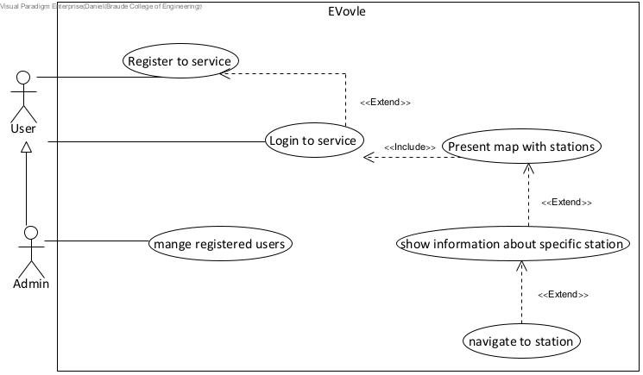
Use Case Diagram
Research
&
Engineering Process

Slide 10
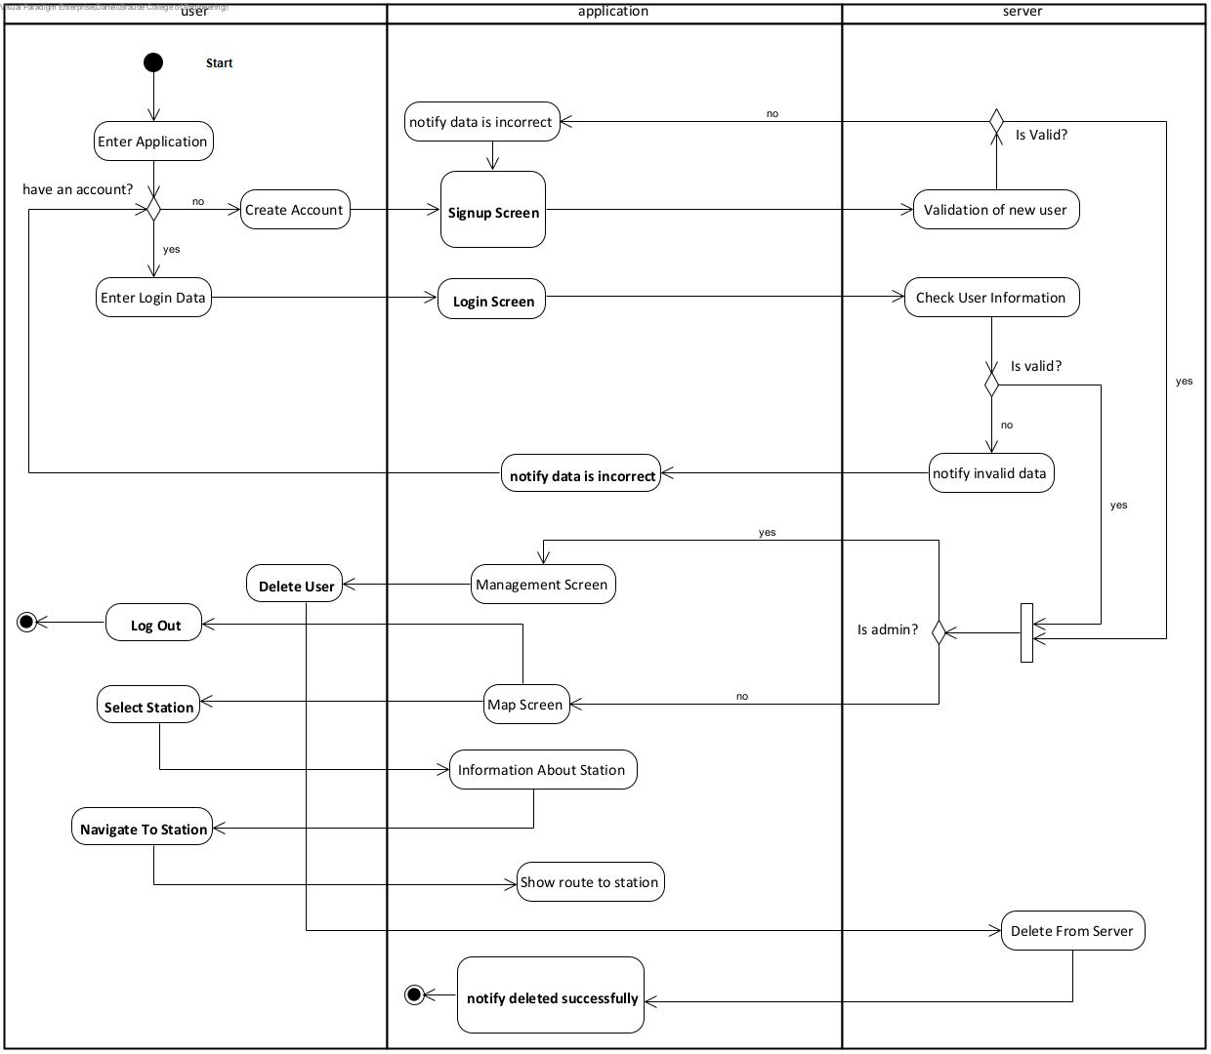
Activity Diagram
Research
&
Engineering Process

Slide 11
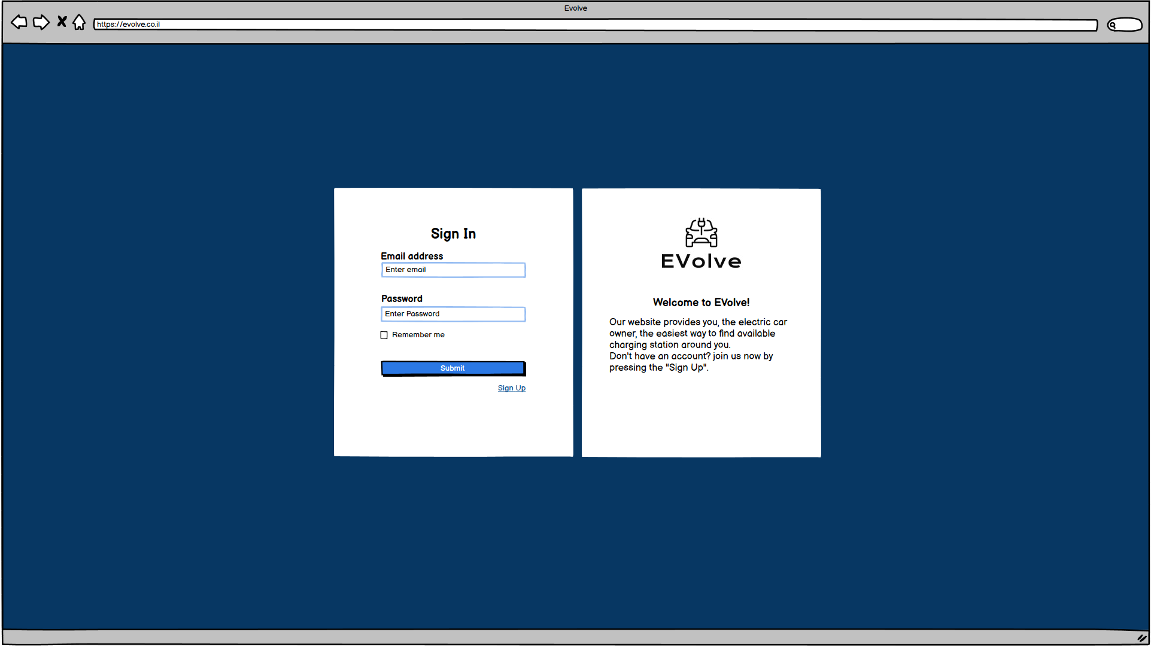
Graphical User Interface
Research
&
Engineering Process

Slide 12
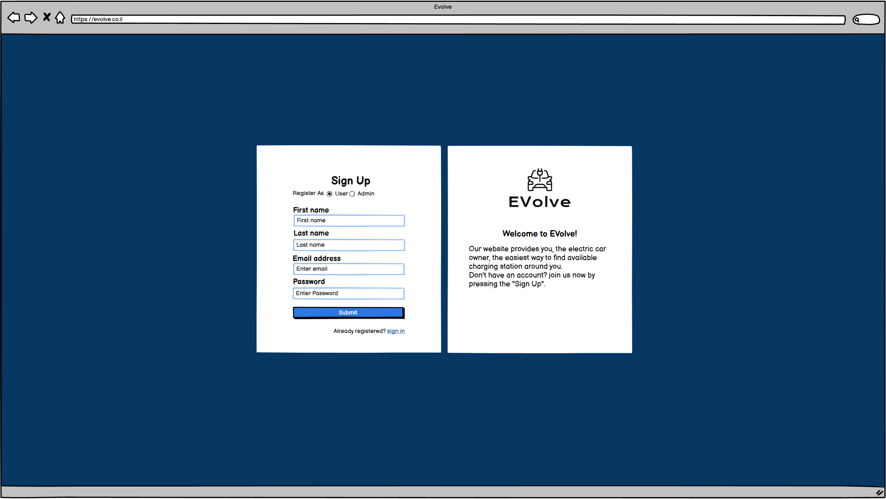
Graphical User Interface
Research
&
Engineering Process

Slide 13
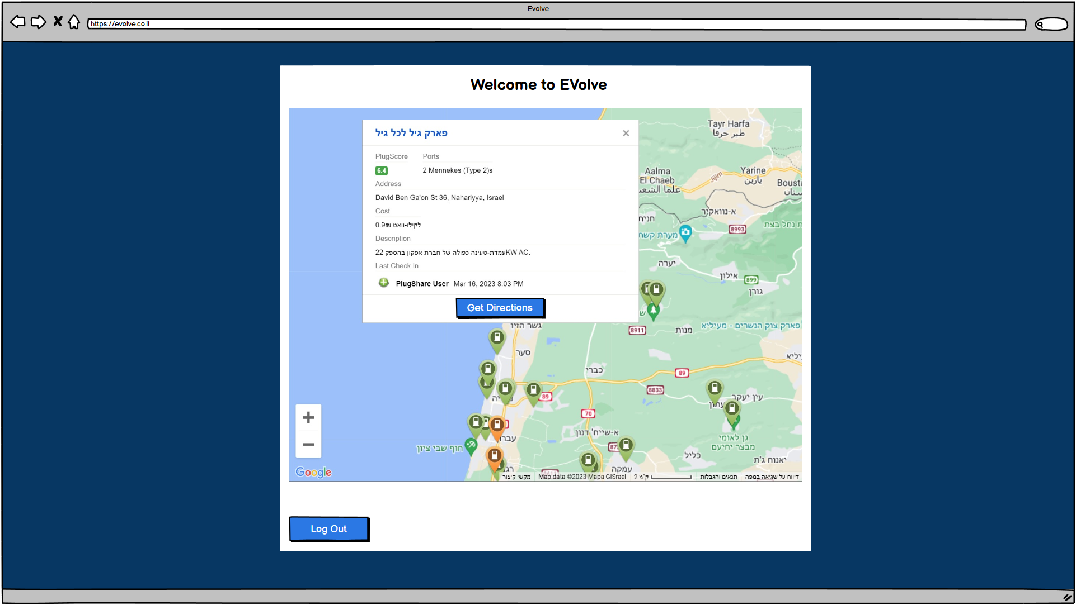
Graphical User Interface
Research
&
Engineering Process

Slide 14
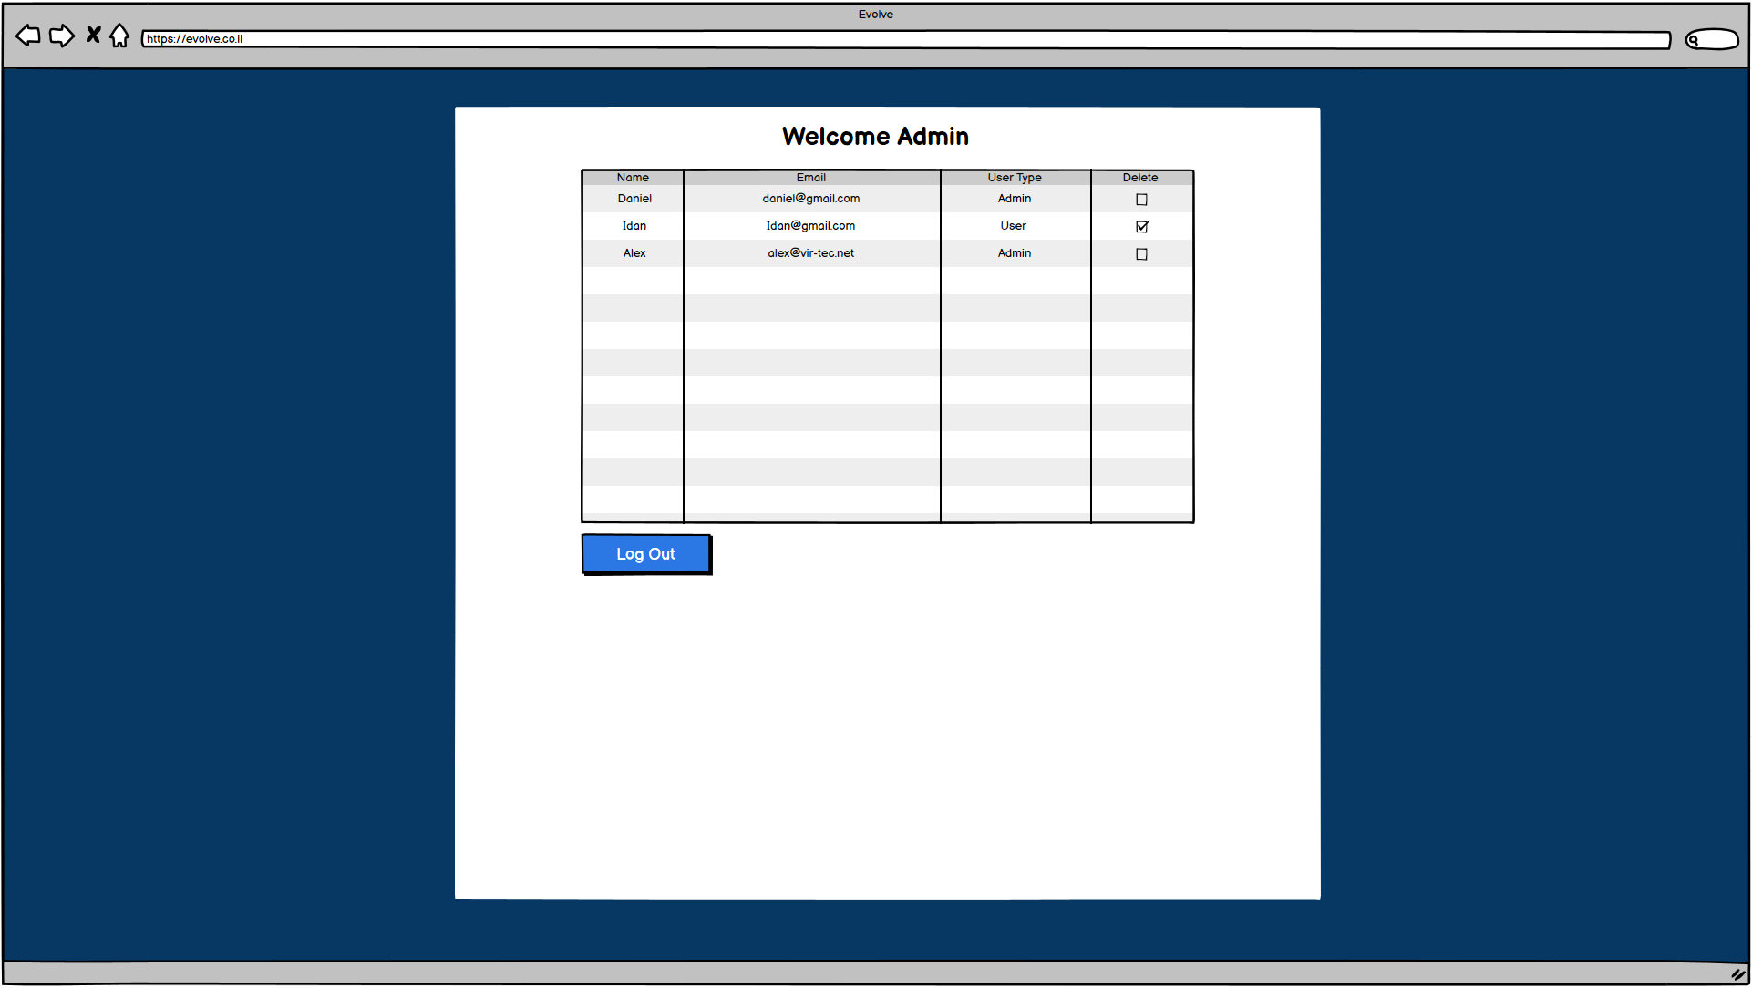
Graphical User Interface
Research
&
Engineering Process

Slide 15

We found that the articles are not clear-cut and even confusing. We have decided to conduct comparisons based on the parameters that we want our application to achieve (App size, Performance etc).
Research
&
Engineering Process
Notes:
Thank you Idan.
So, after we finished our application definition process, we started looking for an articles and researches about the different frameworks. Surprisingly, the articles we found were confusing since each article showed the frameworks from different aspects. So, what decided to do is to make our one compressions based on parameters that we want our application will achieve.

Slide 16


Additionally, we conducted research on a few APIs that we intended to utilize in our project to ensure compatibility and optimal functionality. We found that the Google Maps API and PlugShare API are compatible with our project and meet our requirements.
Research
&
Engineering Process
Notes:
We also had to research and choose the APIs that we want to work with.
Since our application shows a map and allows navigation, we first had to choose a map service API. We chose Google Maps service because it’s the most popular at the moment and its also pretty easy to use and of course compatible with our application. We also had to find an API that will provide the information about the charging stations. We found an API called PlugShare which provides also the locations on the stations and also the status on the stations.

Slide 17
We chose to focus on JavaScript based frameworks due to their dynamic content modification capabilities and ease of implementation.
We chose to focus on:
Angular
React
Preact
Solution Overview
Notes:
Now we will explain about our solution.
So, as Idan said, there are thousands of frameworks that available at the moment. We decided first to focus on JavaScript based frameworks because JavaScript is pretty easy to learn and implement with. Then we looked for a popular frameworks with large community and we choose to focus on Angular, React and Preact.

Slide 18
We will develop the same application “EVolve” twice:
1. React + Tailwind
2. Angular + Bootstrap
Solution Overview
For the server-side: Node.js (with MongoDB as database)
Notes:
What we will do is to develop our application Evolve twice: first using react and tailwind for the CSS and second time using Angular and bootstrap for CSS. The server side will be implemented using node.js with MongoDB as our database. We will actually receive here three versions of our application because React and Preact have the same syntax so we can easily change between them.

Slide 19
Then we will perform the same performance testing on the application in its two variations. We hope that this way we will obtain unequivocal results. These results will assist us in providing advice to other web developers on which framework to choose for their web applications.
Solution Overview
Notes:
After both versions will be ready we will perform a performance testing. We hope that the results of this tests will help us to get a conclusion which framework is the best for our application and also allow us to advice other developers with the results so they can choose the best framework for their applications.

Slide 20
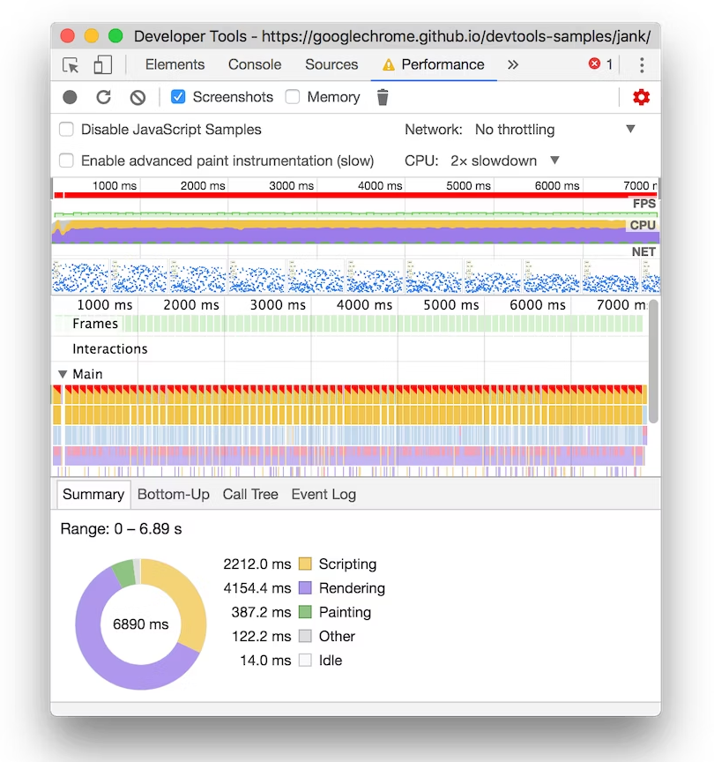
Performance Testing
We will use the built-in chrome devtools performance checker tool.
Verification Plan
Notes:
For the performance testing we will use the built in tool in the chrome browser you can see it here. Using this tool we can analyze the total time that took for the application to load, and also get an information about the time of scripting and rendering.

Slide 21
System Testing
Test No. | Test Subject | Expected Result
1. | User enters an email in the wrong format and press submit. | Pop up with an error message.
2. | User tries to login with the wrong user name. | Alert message “wrong username or password” appears.
3. | User tries to login with the wrong password. | Alert message “wrong username or password” appears.
4. | User tries to register as Admin with the wrong secret key. | Alert message “Invalid Admin” appears
5. | User tries to register with the wrong email format. | Pop up with an error message.
6. | An already registered user tries to register using the same email address. | Alert message “Something went wrong” appears.
Verification Plan
Notes:
We will also perform a system testing to ensure the application functionality works as we wanted. Here you can see a table with some of the test we will perform. So, for example, if a user enters wrong user name or password, he will receive an error message.

Slide 22

Choosing the best framework for a user-centric web application while ensuring a seamless user experience.
Providing a comprehensive solution for informed framework selection.
Researching and ensuring API compatibility.
Challenges
Notes:
During the whole process we faced few challenges, the first one was to choose frameworks to focus on that are also popular but also will provide best user experience.
We also had to decide how we will measure and provide our solution for other developers so they will make a smart choice for their applications.
And finally, we faced the problem of finding an API that will provide us an updated information about the charging stations for our application.

Slide 23
Thank you
Do you have any questions?
Notes:
Thank you for listening!

